Slide 1
Requirements Modeling: Sequence Diagram

Slide 2
Sequence Diagram
The sequence diagram represents the flow of messages in the system.
Purpose of a Sequence Diagram
To model high-level interaction among active objects within a system.
To model interaction among objects inside a collaboration realizing a use case.
It either models generic interactions or some certain instances of interaction.

Slide 3
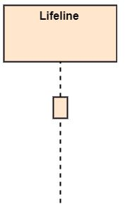
Notations of a Sequence Diagram
Lifeline
An individual participant in the sequence diagram is represented by a lifeline.
It is positioned at the top of the diagram.
Activation
It is represented by a thin rectangle on the lifeline
It describes that time period in which an operation is performed by an element.

Slide 4
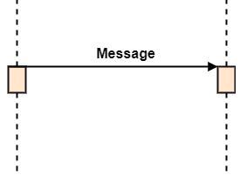
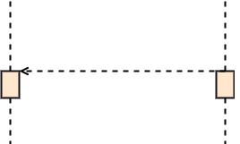

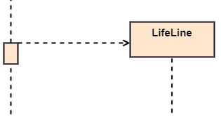
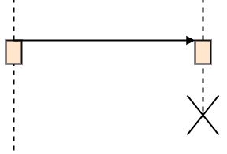
Notations of a Sequence Diagram
Messages: depict the interaction between the objects and are represented by arrows
Call Message: It defines a particular communication between the lifelines of an interaction, which represents that the target lifeline has invoked an operation.
Return Message: It defines a particular communication between the lifelines of interaction that represent the flow of information from the receiver of the corresponding caller message.
Self Message: It describes a communication, particularly between the lifelines of an interaction that represents a message of the same lifeline, has been invoked.
Create Message: It describes a communication, particularly between the lifelines of an interaction describing that the target (lifeline) has been instantiated.
Destroy Message: It describes a communication, particularly between the lifelines of an interaction that depicts a request to destroy the lifecycle of the target.

Slide 5
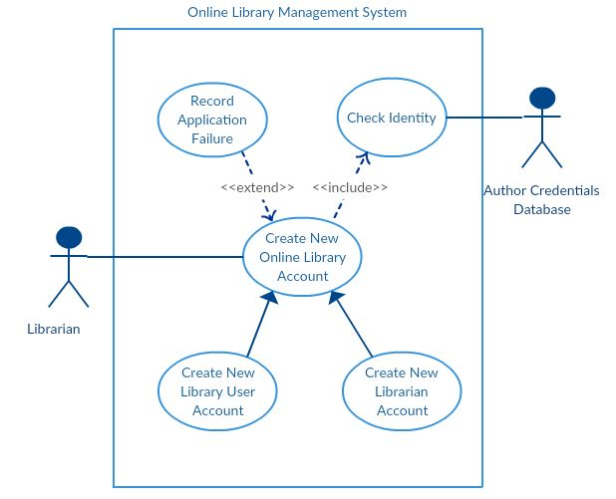
Drawing Sequence Diagram
A sequence diagram represents the scenario or flow of events in one single use case.
The message flow of the sequence diagram is based on the narrative of the particular use case.

Slide 6
Drawing Sequence Diagram
A sequence diagram for “ Create New User Account”
Identify the objects or actors
Librarian
Online Library Management system
User credentials database
Email system
Figure out the interactions
The librarian request the system to create a new online library account
The librarian then selects the library user account type
The librarian enters the user’s details
The user’s details are checked using the user Credentials Database
The new library user account is created
A summary of the of the new account’s details are then emailed to the user

Slide 7
Drawing Sequence Diagram
Admin: Librarian
: LMS
ucd: UserCredentialDB
es:EmailSystem

